Slide 1
Kansas Volkswagen Settlement Program
September 2017
Kelly Gilbert
kelly@metroenergy.org
816-531-7283

Slide 2
Mission: To create resource efficiency, environmental health and economic vitality in mid-America.
Transforming energy use in America’s Heartland
since 1983
Programs
Alternative Fuels and Clean Transportation
Kansas City Regional Clean Cities Coalition
Central Kansas Clean Cities Coalition
Energy Efficiency in Buildings
Energy and Environmental Training
Notes:
Metropolitan Energy Center is a 30-year-old Missouri nonprofit company, whose mission is to create resource efficiency, environmental health and economic vitality in Mid-America. Our programs range from Energy Efficiency in the built environment, to energy and environmental training, to alternative fuels and clean transportation. Under the transportation umbrella, we staff the Kansas City Regional Clean Cities Coalition and Central Kansas Clean Cities, which is based in Wichita.

Slide 3
Department of Energy Clean Cities program
The U.S. Department of Energy's (DOE’s) Clean Cities program advances the nation's economic, environmental, and energy security by supporting local actions to cut petroleum use in transportation. Since it’s inception in 1993 we have displaced more than 8.5 billion gallons of petroleum.
Our Mission
Clean Cities advances the energy, economic, and environmental security of the United States by supporting local actions to cut petroleum use in transportation.

Slide 4
Kansas City Region and Central Kansas Clean Cities
Kansas City Regional Clean Cities
Established in 1998 Housed at Metropolitan Energy Center Staff Kelly Gilbert (kelly@metroenergy.org) David Albrecht (david@metroenergy.org) Funding U.S. Department of Energy U.S. Environmental Protection Agency Local contracts Dues from stakeholders
Central Kansas Clean Cities
Established in 2013 Housed at Metropolitan Energy Center Staff Kelly Gilbert (kelly@metroenergy.org) Shawn Schmidt (shawn@metroenergy.org) Funding Kansas Soybean Commission Kansas Corn Dues from stakeholders

Slide 5
VW Settlement Funding Breakdown
U.S. EPA complaint against Volkswagen, AG regarding Clean Air Act violations in approximately 580,000 model year 2009 to 2016 motor vehicles containing 2.0 and 3.0 liter diesel engines.
$14.7 billion to settle allegations of cheating emissions for the 2L engines. Settlement funds will be used to reduce NOx emissions with three projects:

Slide 6
ZEV Investment

Slide 7
ZEV Investment: The National Plan
The Volkswagen Group of America created Electrify America LLC, a wholly-owned subsidiary, to fulfill its Appendix C commitments.
The investment: $1.2 billion
The plan: “National ZEV Investment Plan” at www.electrifyamerica.com (first 30-month cycle)
Cycle 1 | Cycle 2 | Cycle 3 | Cycle 4
(Q1 2017 – Q2 2019) | (Q3 2019 - Q4 2021) | (Q1 2022 – Q2 2024) | (Q3 2024 – Q4 2026)
$300M | $300M | $300M | $300M

Slide 8
ZEV Investment: Infrastructure Details
450+ Corridor-based station sites
Along EV Charging Corridors recently designated by the Federal government
39 states
~ 66 miles apart, with no more than 120 miles between stations.
Each site
4-10 150 kW Level 2 and at least 1 320 kW DCFC.
300+ Community-based charging station sites
Workplaces, retail, multifamily residential locations, municipal lots and garages
11 target metropolitan areas:
Boston, Chicago, Denver, Houston, Miami, New York City, Philadelphia, Portland, Raleigh, Seattle and Washington, D.C.
Level 2 and/or DC Fast Chargers from 50 to 150+ kW.

Slide 9
ZEV Investment: Impact
Advanced charging technology.
320 kW charging can add about 19 miles per minute, for
200-300 miles of charge in only 15-20 minutes.
Compatible with most brands.
multiple technologies (Level 2 and DC fast charging),
non-proprietary connectors,
and multiple fast-charging protocols
An educational campaign will impart the benefits of ZEVs and address consumer barriers to adoption.
For more information: www.electrifyamerica.com

Slide 10
Environmental Mitigation Trust

Slide 11
Environmental Mitigation Trust
$2.7 billion will be placed in an Environmental Mitigation Trust, and will be allocated to beneficiaries (states, tribes, and certain territories) based on the number of impacted VW vehicles in their jurisdictions
Funding for projects that reduce NOx emissions.
Kansas 2.0L allocation: $14,791,372
Each state designates a lead agency that will have the delegated authority to act on behalf of the state.
Kansas Department of Health and Environment

Slide 12
“Second Partial Consent Decree” for 3.0 Liter Subject Vehicles
Department of Justice web page (U.S. District Court) http://www.cand.uscourts.gov/vwmdl/proposed-settlement-3-liter
$225 million proportionally divided among the states (adds to each state’s Trust funds).
Kansas 3.0L allocation: $870,866
KS total allocation: $15,662,238

Slide 13
Eligible Mitigation Actions
Eligible Large Trucks
1992-2009 model year Class 8 Local Freight or Drayage
Eligible Large Trucks must be scrapped, and may be Repowered or replaced with any new diesel, alternative fueled, or all-electric engine
Eligible Buses
2009 model year or older Class 4-8 school buses, shuttle buses, or transit buses
Including buses under contract to
Eligible buses must be scrapped, and may be Repowered or replaced with any new diesel, alternative fueled, or all-electric engine
Eligible Medium Trucks
1992-2009 model year Class 4-7 Local Freight Trucks
Eligible medium trucks must be scrapped, and may be Repowered or replaced with any new diesel, alternative fueled, or all-electric engine
…and Eligible Freight Switchers
Pre-Tier 4 switcher locomotives that operate 1000 or more hours per year
Eligible Freight Switchers must be scrapped, and may be Repowered or replaced with any new diesel, alternative fueled, or all-electric engine or Freight Switcher that is certified to meet applicable EPA emissions standards
Trucks & Buses

Slide 14
Eligible Mitigation Actions
Trucks and Buses (and Freight Switchers) | Percentage of Project That Can Be Funded Through Trust
 | Government-Owned Eligible Trucks and Buses, or Buses Under Contract with Public School District | Non-Government Owned Eligible Trucks and Buses
Repower with new diesel or AFV engine | Up to 100% | Up to 40%
Purchase new diesel or AFV vehicle | Up to 100% | Up to 25% (50% for drayage trucks)
Repower with all-electric engine, including infrastructure | Up to 100% | Up to 75%
Purchase new all-electric vehicle, including infrastructure | Up to 100% | Up to 75%

Slide 15
Eligible Mitigation Actions
Airport Ground Support and Forklifts | Percentage of Project That Can Be Funded Through Trust
 | Government Owned Eligible Airport Ground Support Equipment | Non-Government Owned Eligible Airport Ground Support Equipment
Repower with all-electric engine, including infrastructure | 100% | 75%
Purchase new all-electric equipment, including infrastructure | 100% | 75%
Eligible Airport Ground Support Equipment
Tier 0, Tier 1, or Tier 2 diesel powered airport ground support equipment, and uncertified or certified to 3 g/bhp-hr or higher emissions, spark ignition engine powered airport ground support equipment
Eligible airport ground support equipment must be scrapped, and may be Repowered with an all-electric engine, or replaced with the same equipment in an all-electric form
Eligible Forklifts
Forklifts with greater than 8,000 pounds lift capacity
Eligible forklifts must be scrapped, and may be Repowered with an all-electric engine, or replaced with the same equipment in all-electric

Slide 16
Eligible Mitigation Actions
EVSE and H2/FCVSE | Percentage of Project That Can Be Funded Through Trust
EVSE - publicly available at government owned property | 100%
EVSE - publicly available at non-government owned property | 80%
EVSE - at workplace but not available to general public | 60%
EVSE - at multi-unit dwelling but not available to general public | 60%
FCVSE - publicly available and able to dispense at least 250kg/day | 33%
FCVSE - publicly available and able to dispense at least 100kg/day | 25%
Light Duty Zero Emission Vehicle Supply Equipment
May use of to 15% of its allocation of Trust Funds on the costs to acquire, install, operate and maintain new light duty ZEV supply equipment. Eligible projects include:
Level 1, Level 2 or DC fast chargers located in a public place, workplace, or multi-unit dwelling
Hydrogen fuel cell supply equipment, including hydrogen dispensing equipment that is located in a public place

Slide 17
Eligible Mitigation Actions
Eligible Ferries/Tugs
Unregulated, Tier 1 or Tier 2 marine engines
Eligible ferries and tugs must be scrapped, and may be Repowered with any new Tier 3 or Tier 4 diesel, alternative fueled, or all-electric engines or may be upgraded with an EPA Certified Remanufacture System or an EPA Verified Engine Upgrade
 | Percentage of Project That Can Be Funded Through Trust
 | Government-Owned Ferries and Tugs | Non-Government Owned Ferries and Tugs
Repower with new diesel, AFV engine | 100% | 40%
Repower with all-electric engine, including infrastructure | 100% | 75%

Slide 18
Eligible Mitigation Actions
Eligible Ocean Going Vessels (OGV) Shorepower
Systems that enable a compatible vessel’s engines to remain off while the vessel is at berth. Components eligible for reimbursement include cables, cable management systems, shore power coupler systems, distribution control systems, and power distribution components
Eligible OGVs may be Repowered with any new Tier 3 or Tier 4 diesel, alternative fueled, or all-electric engines or may be upgraded with an EPA Certified Remanufacture System or an EPA Verified Engine Upgrade
 | Government-Owned Marine Shorepower | Non-Government Owned Marine Shorepower
Costs associated with shore-side system | 100% | 25%

Slide 19
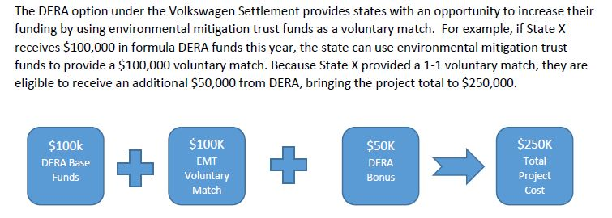
Eligible Mitigation Actions
Diesel Emission Reduction Act (DERA) Option
may use Trust Funds for non-federal match or overmatch for DERA
allows beneficiaries to use Trust Funds for actions not specified in the settlement, but otherwise eligible under DERA (e.g. diesel emission mitigation retrofits)
Source: NASEO Volkswagen Beneficiary Mitigation Plan Toolkit

Slide 20
Spending Allocations
Up to 10 years to spend 80%
Up to 1/3 of its allocation in Year 1
Up to 2/3 of its allocation by Year 2
Up to 15 years to spend 100%
Occasional reapportionment of unused funds.

Slide 21
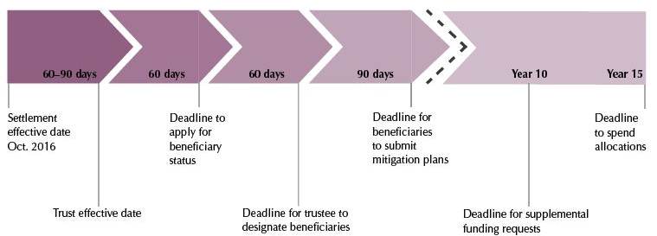
What Happens Next?
State assigns beneficiary agency
Takes in constituent feedback
State makes high-level policy decisions
What % does state keep for its fleet?
What % for local government? For private/commercial?
What policies will drive its funding decisions?
State releases detailed mitigation plan

Slide 22
Resources to assist policy decisions
Volkswagen Environmental Mitigation Trust: Recommendations for the State of Kansas (Central Kansas and KC Regional Clean Cities)
metroenergy.org/programs/clean-cities/projects/volkswagen-settlement/
Volkswagen Settlement: Beneficiary Mitigation Plan Toolkit (NASEO: National Association of State Energy Officials)
www.naseo.org/volkswagen-settlement

Slide 23
Recommendations for the State of Kansas

Slide 24
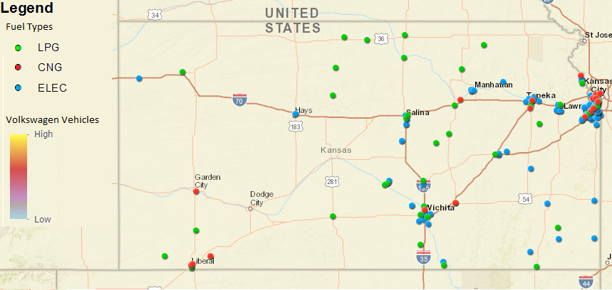
Recommendations for the State of Kansas

Slide 25
Recommendations for the State of Kansas

Slide 26
NASEO Mitigation Plan Toolkit - Contents

Slide 27
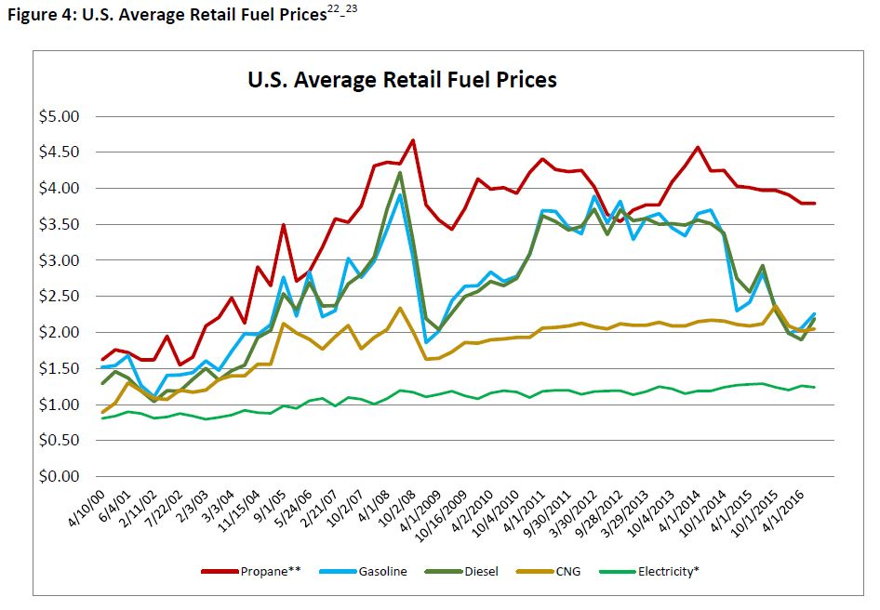
NASEO Mitigation Plan Toolkit

Slide 28
NASEO Mitigation Plan Toolkit

Slide 29
NASEO Mitigation Plan Toolkit

Slide 30
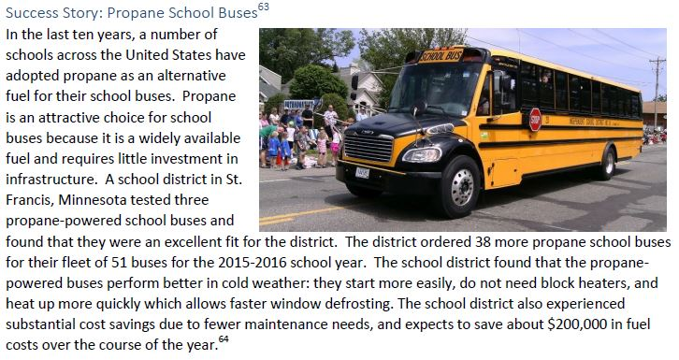
NASEO Mitigation Plan Toolkit

Slide 31
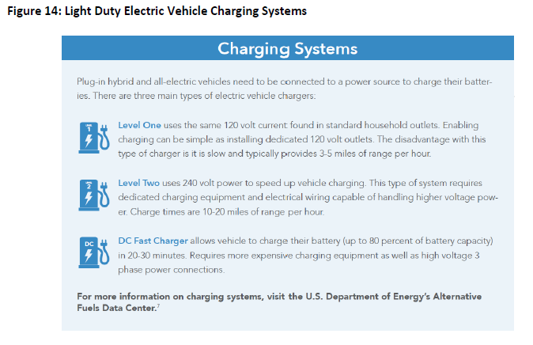
NASEO Mitigation Plan Toolkit

Slide 32
Environmental Mitigation Trust Summary
Every state has the opportunity to participate
Diesel vehicles, truck and bus Classes 4-8
Aging diesel vehicles, MY 1992-2009
(2010-2012 for states w mandates)
Destruction of replaced vehicles required
Various off-road and marine options
Electric Vehicle Supply Equipment
Kansas
$15 million

Slide 33
Kansas Forums - Upcoming
Topeka, September 13
- Hosted by Clean Energy Business Council
Wichita, October 3
- Hosted by WSU
metroenergy.org/events/

Slide 34
Thank you
How would you use VW (and other Clean Air Act) settlement funds?
http://tinyurl.com/z4r4a7l
Kelly Gilbert, Kansas City: kelly@metroenergy.org
metroenergy.org/events/

